Slide 1
Ordering Page
Major defects flow from minor inaccuracies in the coded prices for the Meat Extravaganza pizza and the Peppers topping. Correcting these errors at the source likely will redress related major defects listed downstream.
Inability to remove a pizza in Internet Explorer 11 produces a set of critical defects. Fixing the “remove” button code likely will have a domino-effect, resolving all listed critical defects. Fixing the remove button will render the page functional on the most recent version of that browser.
Price freeze after £100 in the basket.
If item is in the shopping basket and user navigates to the Home page, Ordering Page, About Page or Contact page and then tries to navigate back to the Ordering Pizza page, the Schedule page eventuates. No means of being able to navigate back via navigation to the Ordering Pizza.
Notes:
The Ordering Page is a page of some complexity and functions arguably as the central feature of the website—and it has been subject to extensive scrutiny as a result. In spite of the page’s complexity, however, and despite a relatively large number of critical and major defects being reported, the page performs rather well under the spotlight. The 7 critical defects and 43 major defects tallied reflect more the volume of tests run on the page than they do its readiness. Although these critical and major defects are such in isolation, it appears likely—estimated from the relatively large number of tests performed—that the majority of critical and major defects stem from common root sources which, if corrected, likely would negate the critical and major errors that flow from them.
All critical defects classified flow from the function of the “remove” button in Internet Explorer not behaving. In the most recent version of Internet Explorer 11 and an earlier version of 11, when a pizza is added to the shopping cart, the remove function fails to remove it. The pizza remains in the cart and its price remains. This is problematic particularly because navigating to another page on the website and then navigating back to the Ordering Pizza page brings the user to the Schedule page. Fixing the remove button in the IE 11 code would at once remove all 7 listed critical defects.
The next set of major defects appear to associate with inaccuracies in the encoded prices for the Meat Extravaganza and the Peppers topping. The Ordering Page reveals accurately the price of the Meat Extravaganza to be £7.49—as stated in the Requirements—but the code for the site inputs £7.94 when the “Add to Cart” button is clicked. It is expected that rectifying the code’s price will assist in dispelling the defects that appear when pizza combinations involving the Meat Extravaganza are added to the cart. Likewise, in the case of the Peppers, the coded price is 40p, which contrasts with the Requirements’ prescribed 50p. Based on the calculation of the expected price versus the actual price for each Test Procedure involving a Meat Extravaganza and/or Peppers topping, it appears reflected each time that—if the Meat Extravaganza price and Peppers price were corrected at the source—the overall price produced would be accurate to the Requirements, which would negate the Major defects listed in the page tests pertaining to inaccurately produced prices. In total, these two corrections combined would potentially nullify a further 30 major defects.
An additional run of major defects result from a price freeze that occurs across all browsers once a certain price is reached in the shopping cart. Price freeze potentially dangerous since pizzas can continue to be added and the Receipt page can be reached before the user discovers that the price has frozen. The Receipt page gives an accurate reading of price. Twenty pizzas are on display in the shopping cart, so the list of items is accurate, and the price for each pizza is accurate. However, the total price of all the pizzas in the cart appears to freeze once the total order price exceeds £100. For example, when thirteen Meat Extravaganzas are added, the price in the cart comes to a total of £103.22 (for SS: should be 111.16)—and adding any more pizzas beyond that does add a pizza to the cart, but doesn't reflect the addition in the total price. For example, whenever more than twelve Classic Deluxe Pizzas are added, a new pizza appears in the shopping cart, but the additional price of that pizza is not added to the running total displayed on the Ordering Page: it is stuck at £107.88. (SS: Should be 134.85) It is uncertain what may have caused this error but it may be attributable to the price counter on the Ordering page alone, as the error is not reflected on the Order Receipt page, which, in the case of the twelve Classic Deluxe Pizzas, gives the accurate total of £179.8. In other words, the user may think he/she has acquired 12 Classic Deluxe Pizzas for £107.88, but by the time order receipt is confirmed, the user will then discover that £179.8 has been spent.
No matter the web browser or the device, if the user has an item in the shopping basket and navigates to the Home page, Ordering Page, About Page or Contact page and then tries to navigate back to the Ordering Pizza page, the user will instead find herself or himself on the Schedule page--with no means of being able to navigate back to the Ordering Pizza page via the website, instead needing to resort to the back buttons for the web browsers. This could be fixed by rectifying the link to where the user is meant to go when there's an item in the basket.
Meat Extravaganza is supposed to be £7.49, but its website price is £7.94.
Peppers supposed to be 50p; it’s actually 40p.
describe it; describe section it came in; impact assessment--what happens if we leave it as it is; e.g. no individual receipt number, fight over pizzas--and suspected cause--your best guess as to what caused this; testers need to know a bit about underlying architecture and software, so make a guess as to where the problem might be; it'll save time for devs.

Slide 2
Myriad cosmetic and minor that could be corrected if the page is being revisited anyway. E.g. Pizza descriptions.
Many classified moderates are negated once source problems (chiefly, the pizza prices) are corrected.

Slide 3
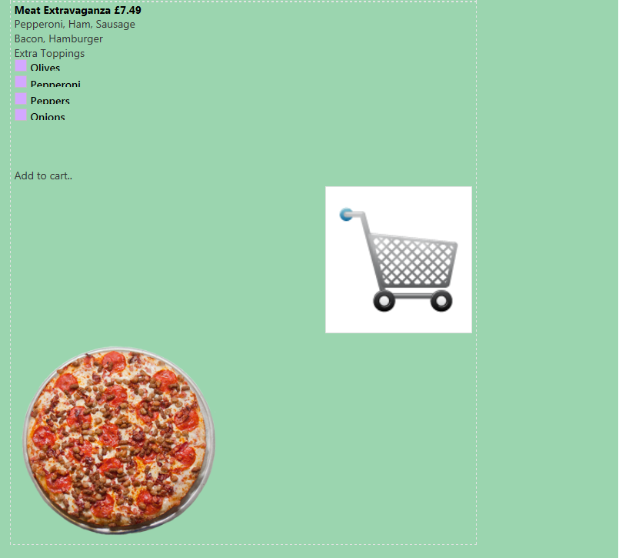
Meat Extravaganza – price £7.49.

Slide 4
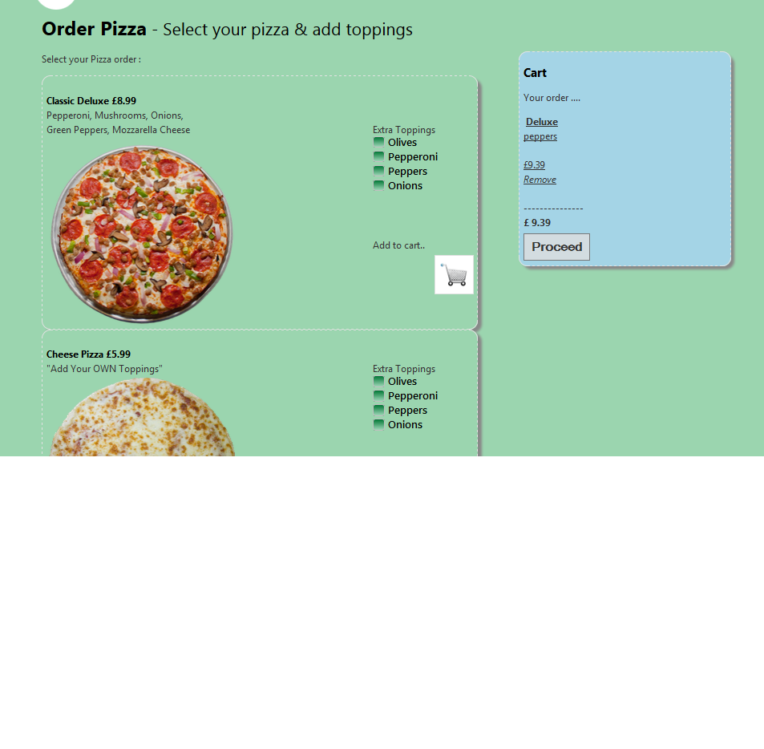
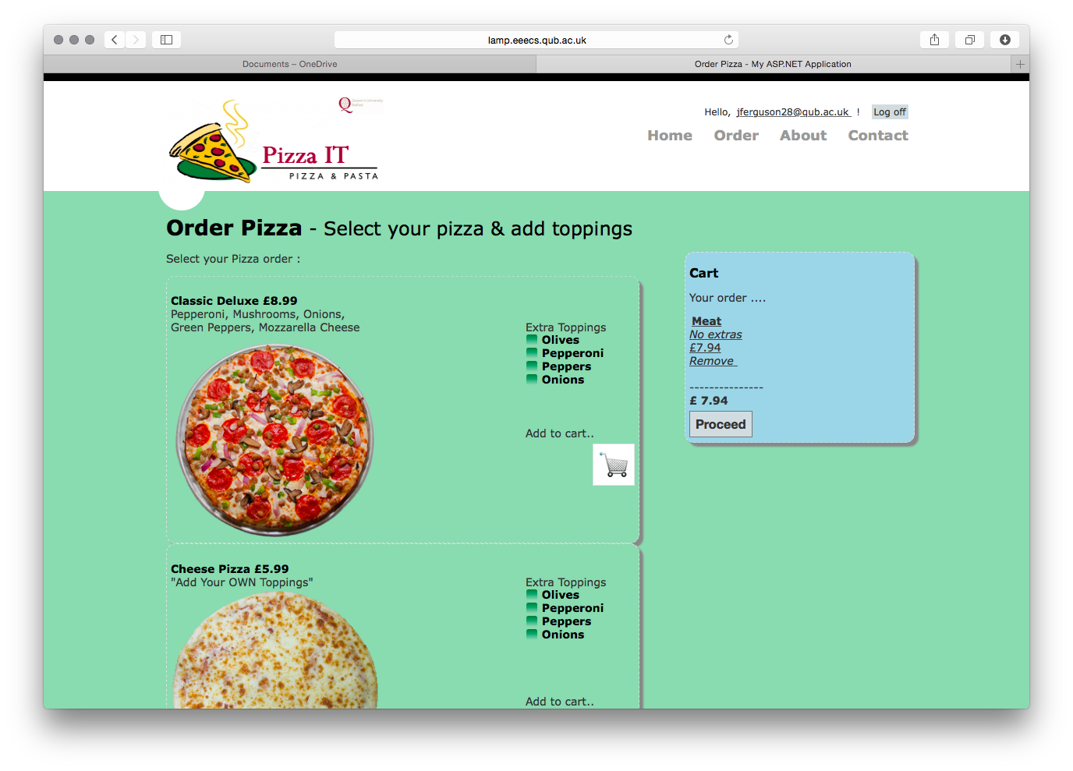
Peppers bring the price up to 9.39; peppers at 40p. Price should be 9.49.
Onions don’t add to basket with Cheese Pizza.

Slide 5
